Slide 1
Serverless Eventing with Azure Event Grid

Slide 2

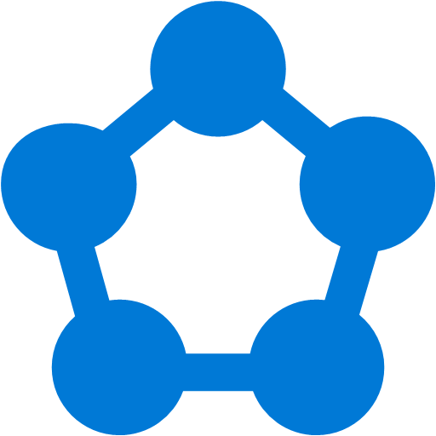









Modern computing is all about events
Notes:
Events moving around in chaos
City slides up and question marks fade in and wiggle back and forth

Slide 3
?
Managing events is important but cumbersome
?
?
?
?
?
?
?
?
?
?
?
Notes:
Events moving around in chaos

Slide 4

What if all these events could be managed and directed from one place?
Notes:
Events moving around in chaos

Slide 5
Azure Event Grid
Fully-managed event routing
Near real-time event delivery at scale
Broad coverage within Azure and beyond
Backbone of event-driven computing
Notes:
OOTB Publishers + Custom Capabilities
Here are some of the key features of Azure Event Grid:
Simplicity - Point and click to aim events from your Azure resource to any event handler or endpoint.
Advanced filtering - Filter on event type or event publish path to ensure event handlers only receive relevant events.
Fan-out - Subscribe multiple endpoints to the same event to send copies of the event to as many places as needed.
Reliability - Utilize 24-hour retry with exponential backoff to ensure events are delivered.
Pay-per-event - Pay only for the amount you use Event Grid.
High throughput - Build high-volume workloads on Event Grid with support for millions of events per second.
Built-in Events - Get up and running quickly with resource-defined built-in events.
Custom Events - use Event Grid route, filter, and reliably deliver custom events in your app.

Slide 6
Benefits
Focus on innovation and pay per event
Ensure reliability and performance for your apps
Unlock new scenarios for your apps
Manage all events in one place
Notes:
Tord Glad Nordahl : “With dynamic scale and consistent performance Azure Event grid lets you focus on your app logic rather than the infrastructure around it."

Slide 7
What’s the missing piece?
Azure Functions – Serverless compute
Logic Apps – Serverless connectivity and workflows
Service Bus – Serverless messaging
Event Grid – Serverless Events
Completes serverless messaging capability

Slide 8
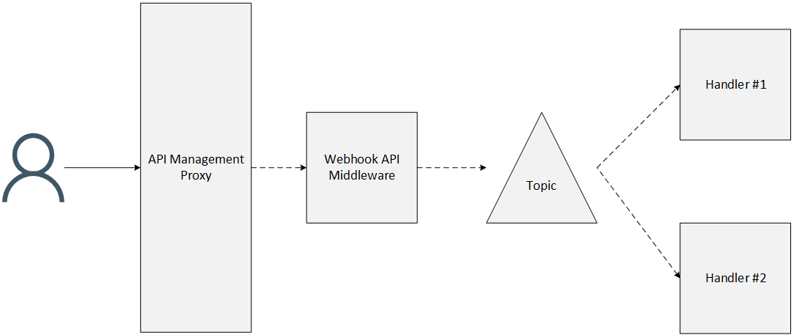
Handling Webhook Events
Courtesy of Tom Kerkhove: https://blog.tomkerkhove.be/2017/08/22/exploring-azure-event-grid/
Notes:
Even if you use Azure API Management, you still need to have the middleware running behind the API Management proxy since you can't push directly to a topic.

Slide 9
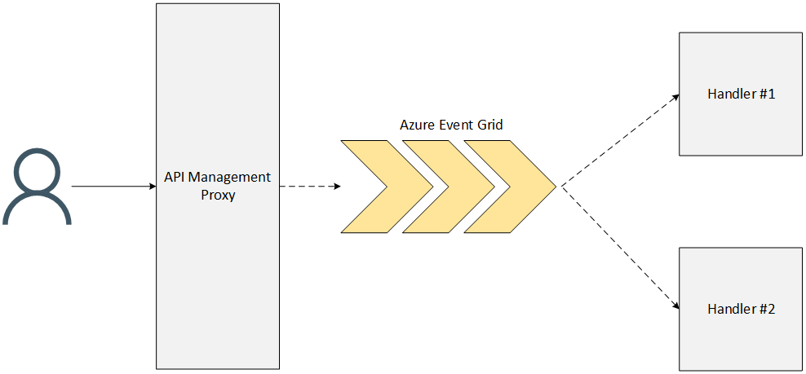
Handling Webhook Events
Courtesy of Tom Kerkhove: https://blog.tomkerkhove.be/2017/08/22/exploring-azure-event-grid/
Notes:
Wouldn't it be nice if we can get rid of that host and let API Management push the requests directly to Azure Event Grid so that it can fan-out all the external notifications to the required processors?
(assumes no validation or business logic)

Slide 10
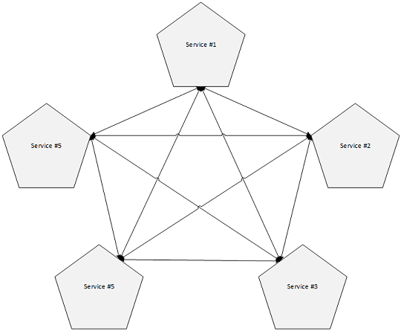
Manage all events in one place
Courtesy of Tom Kerkhove: https://blog.tomkerkhove.be/2017/08/22/exploring-azure-event-grid/
Notes:
Routing logic is embedded in the publishers

Slide 11
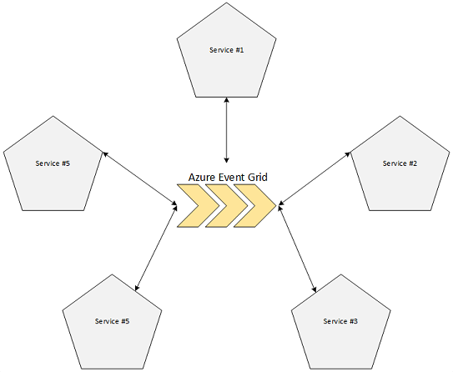
Manage all events in one place
Courtesy of Tom Kerkhove: https://blog.tomkerkhove.be/2017/08/22/exploring-azure-event-grid/
Notes:
Routing logic managed centrally inside Event Grid

Slide 12
Concepts
Event : what happened
Event Publisher : where it took place
Topic: where publishers send events
Event Subscriptions: routes & filters events
Filters: EventTypes, SubjectBeginsWith, SubjectEndsWith
Event Handlers: app or service reacting to the event

Slide 13


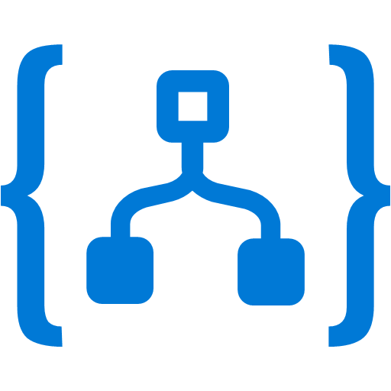




Manage all events in one place
Event publishers
Event handlers
Blob Storage
Azure Functions
Resource Groups
Logic Apps
Azure Subscriptions
Azure Automation
Event Hubs
WebHooks
Custom Events

Slide 14
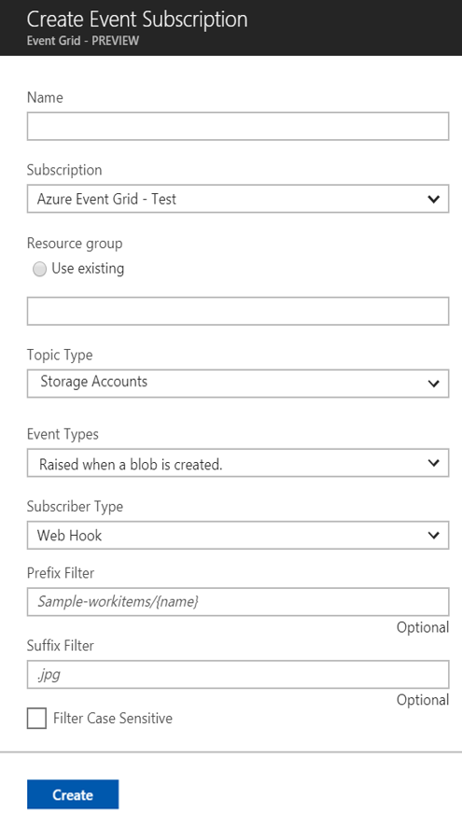
Manage all events in one place
Event publishers
Event handlers
Subscribe to pre-defined system events in Azure or create your own custom topics
Route events to any end-points, Azure or even beyond
Enable filtering and efficient routing of events

Slide 15
Benefit from broad coverage
Publishers
Handlers
Immediately available
Immediately available
Blob Storage
Azure Functions
Resource Groups
Logic Apps
Azure Subscriptions
Azure Automation
Event Hubs
WebHooks
Custom Events
Coming soon
Azure Automation, Azure Active Directory, API Management, Logic Apps, IoT Hub, Service Bus, Azure Data Lake Store, Cosmos DB
Coming soon
Fabric Controller, Service Bus, Event Hubs, Azure Data Factory, Storage Queues

Slide 16
Ensure reliability and performance in your apps
Sub-second end-to-end latency in the 99th percentile*
10,000,000 events per second per region*
24-hour retry with exponential back off for events not delivered
Near real-time
Massive scale-out
High reliability
*Performance targets
Notes:
Based on Service Fabric
99.99% availability
https://docs.microsoft.com/en-us/azure/event-grid/delivery-and-retry
10 seconds
30 seconds
1 minute
5 minutes
10 minutes
30 minutes
1 hour
Event Grid adds a small randomization to all retry intervals.

Slide 17
Azure Messaging by the numbers
1.1 Trillion
Requests every DAY
with Event Hubs
2 Million
Message Queues and Topics in Production
99.9998%
Success rate for service
>30 PB
Monthly Data Volume
42 regions
Running our services
85
Of the 100 largest Azure customers use messaging services
7,098,888
Downloads of our Nuget package
750 Billion
Message operations on Azure Service Bus Messaging (Standard) per month
Notes:
There are many different numbers you can pull in here from the all up “quotable statement list” maintained by PR which can be found here:
https://microsoft.sharepoint.com/teams/WAG/PM/Shared Documents/roadmap (in the Quotable Statements document).

Slide 18
What these big numbers mean…
1,100,000, 000, 000
99.9998%
Requests per day
Success Rate
2.2 million failures

Slide 19
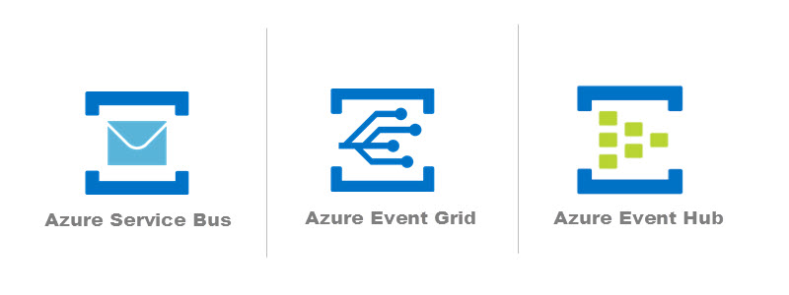
Event Grid, Event Hubs, Service Bus?
Service Bus : Transactions, control, pull
Event Hub : Telemetry, streaming
Event Grid : Event handling, reactive, push
https://buildazure.com/2017/09/07/a-tour-of-azure-messaging-services-queues-event-grid-iot-hub-and-more/
Notes:
Service Bus: High-value enterprise messaging - Order processing and financial transactions
Event Hubs: Big data pipeline - Telemetry and distributed data streaming
Event Grid: Reactive programming - React to status changes

Slide 20
Security
Publishers
Create Subscription
Management Access
Only for custom topics
Key authentication using aeg-sas-key header
SAS Token using aeg-sas-token header r={resource}& e={expiration}& s={signature}
RBAC
Microsoft.EventGrid/ EventSubscriptions/Write permission on the required resource For Azure Publishers: /subscriptions/{id}/ resourceGroups/{rg-name}/ providers/{provider}/ {res-type}/{resource-name} Custom topics
/subscriptions/{id}/ resourceGroups/{rg-name}/ providers/Microsoft.EventGrid/ topics/{topic-name}
RBAC
Microsoft.EventGrid/*/read
Microsoft.EventGrid/*/write
Microsoft.EventGrid/*/delete
Microsoft.EventGrid/ eventSubscriptions/ getFullUrl/action
Microsoft.EventGrid/topics/ listKeys/action
Microsoft.EventGrid/topics/ regenerateKey/action
+ Custom roles
https://docs.microsoft.com/en-us/azure/event-grid/security-authentication
Notes:
Publishing:
Key authentication is easiest (just pass a key)
SAS (recommended) includes resource, expiry and a signature
RBAC for subscription & Mgmt access
Webhooks:
At the time of event subscription creation/update, Event Grid posts a "SubscriptionValidationEvent" event to the target endpoint.
The event contains a header value "Aeg-Event-Type: SubscriptionValidation".
The event body has the same schema as other Event Grid events.
The event data includes a "validationCode" property with a randomly generated string. For example, "validationCode: acb13…".
Only HTTPS is supported

Slide 21
Pricing (public preview)
$0.30 per million operations ($0.60 per million operations upon GA)
Operations include:
Ingress events
Advanced matches
Delivery attempts
Management calls
100,000 free operations per month
Management operations throttled to 10 per second
1,000 event subscriptions per account
Operation definitions, number of free operations, management throttling, and number of subscriptions per account subject to change upon GA

Slide 22
Azure Resource Event Sample
{
"topic": "/subscriptions/{id}/resourcegroups/{rg}",
"subject": "/subscriptions/{id}/resourcegroups/{rg}/providers/Microsoft.Web/connections/azureblob",
"eventType": "Microsoft.Resources.ResourceWriteSuccess",
"eventTime": "2017-09-20T01:46:53.2684149Z",
"id": "9ac0de1a-3cdc-488b-aeb5-087beacb53dc",
"data": {
"authorization": "{\"scope-action-evidence-\":\"\"}}",
"claims": "{\"claim-details-author\":\"\"}",
"correlationId": "9ac0de1a-90cf-4670-ae9f-fccafff7a630",
"httpRequest": "",
"resourceProvider": "Microsoft.Web",
"resourceUri": "/subscriptions/{id}/resourcegroups/{rg}/providers/Microsoft.Web/connections/azureblob",
"operationName": "Microsoft.Web/connections/write",
"status": "Succeeded",
"subscriptionId": "{id},
"tenantId": "9ac0de1a-872d-48cd-84d2-c427b4d640bc"
}
}

Slide 23
Blob Event Sample
[
{
"topic": "/subscriptions/{id}/resourceGroups/{rg}/providers/Microsoft.Storage/storageAccounts/{storageacc}",
"subject": "/blobServices/default/containers/monitored/blobs/blob.json",
"eventType": "Microsoft.Storage.BlobCreated",
"eventTime": "2017-09-20T01:12:35.8066557Z",
"id": "9ac0de1a-001e-00da-23ad-311d4a06bb2f",
"data": {
"api": "PutBlob",
"clientRequestId": "9ac0de1a-9da0-11e7-9a3b-51cc40a2ca27",
"requestId": "9ac0de1a-001e-00da-23ad-311d4a000000",
"eTag": "0x9AC0FC4ADA5997D",
"contentType": "application/json",
"contentLength": 268,
"blobType": "BlockBlob",
"url": "https://{storageacc}.blob.core.windows.net/monitored/blob.json",
"sequencer": "00000000000019200000000000F12B37",
"storageDiagnostics": {
"batchId": "9ac0de1a-e1a1-44c5-a0a1-a66b2a191fc4"
}
}
}
]

Slide 24
Custom Event Sample
{
"topic": "/subscriptions/{id}/resourcegroups/{rg}/providers/microsoft.eventgrid/topics/{topic}",
"id": " 9ac0de1a-83f2-4eb7-ab1f-e2e8d2ef1728",
"eventType": "CryptoCurrencyPriceObtained",
"subject": "cryptoCurrency/price/BTC",
"eventTime": "2017-09-19T11:37:01.1513463+00:00",
"data": {
"AUD": 4991.89
}
}
custom data

Slide 25





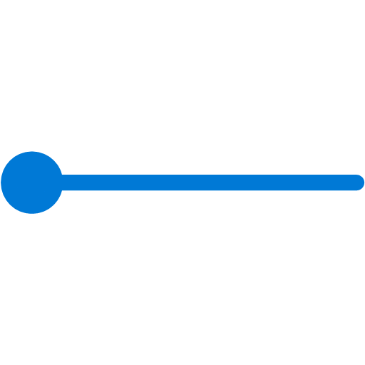

Scenarios
Serverless apps
Ops automation
Third-party integration
Execute code against changes in your data store
Use a function to run a compliance check on each newly created SQL database
Use custom “drive start” and “drive end” events to log vehicle performance metrics
Trigger a function to run Cognitive API when a file is added to storage
Tag newly provisioned VMs with Azure Automation and add to metadata store
Notes:
Connect data sources and event handlers.
Speed automation and simplify policy enforcement.
Connect your app with other services.

Slide 26
Routing Storage Account Events

Slide 27
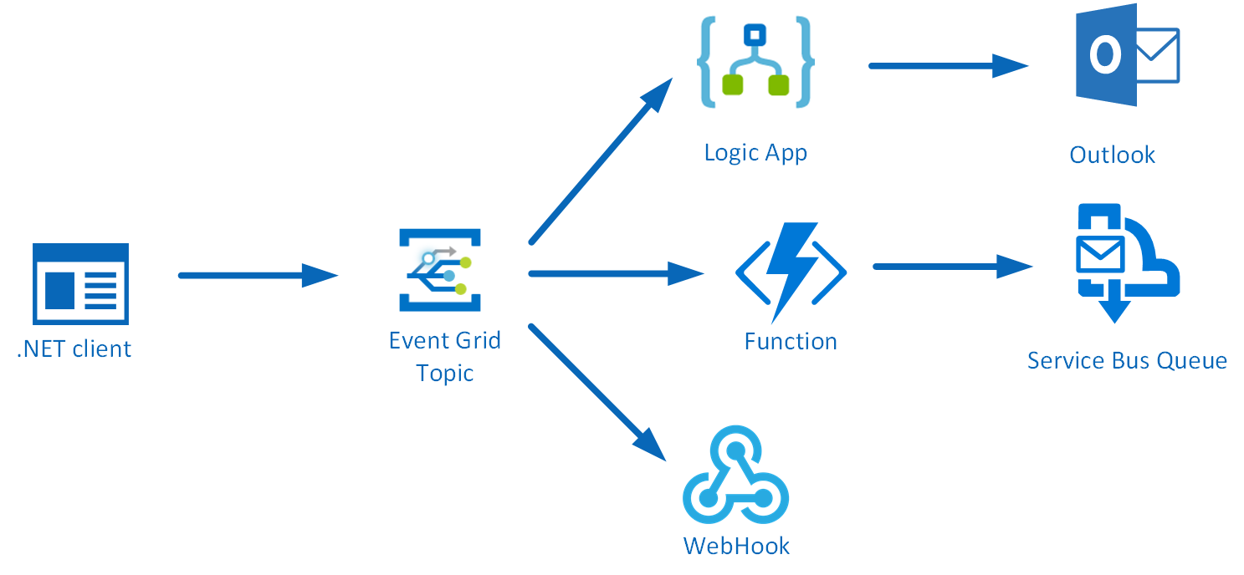
Custom Events Routing with Event Grid Topic

Slide 28

Let’s have some fun

Slide 29
Demo
Routing Blob Storage
Events

Slide 30
Demo
Custom Event Grid Topic Publishing Service Fabric Logging Events

Slide 31
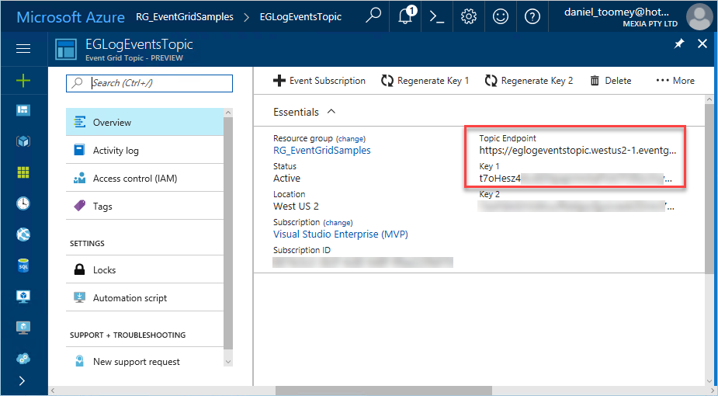
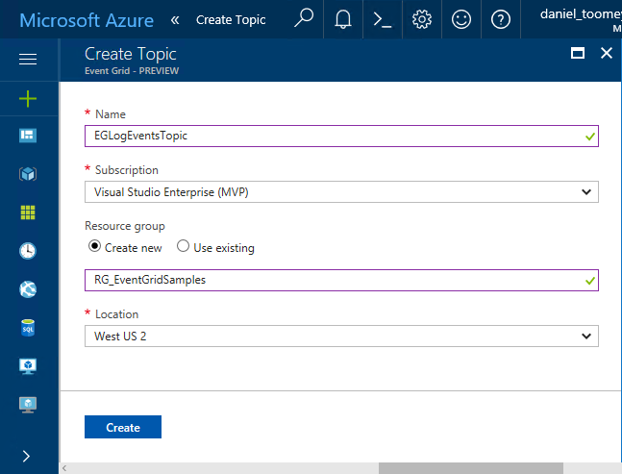
Creating the Event Topic
Notes:
Search for “Event Grid Topic”, and then supply the requested basic information
Only two locations supported right now (West US 2, and West Central US )

Slide 32
Creating the Event Publisher
Add topic endpoint & key to application configuration
Create classes:
The Event class which represents the Event Grid events schema
A LogEvent class which represents the “Data” element in the Event schema
A utility class which includes the static SendLogEvent method
A LogEventType enum to define logging severity levels (ERROR | WARNING | INFO | VERBOSE)
https://blog.eldert.net/sending-custom-events-to-azure-event-grid/
Notes:
Blog post by Eldert describes how to create the Event class

Slide 33
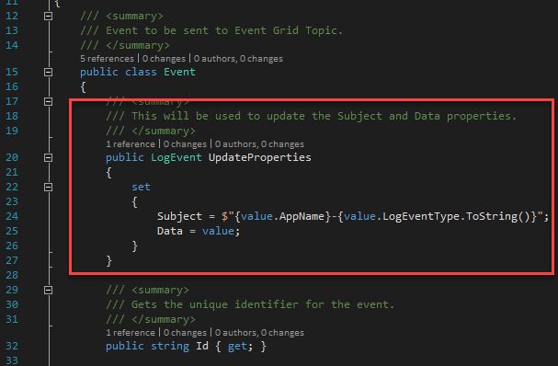
Creating the Event Publisher
Notes:
Assigning properties to the event
Notice how the Event.Subject field is a concatenation of the Application Name and the LogEventType – this will be important later on

Slide 34
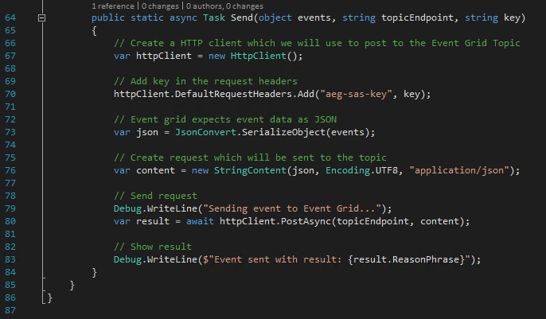
Creating the Event Publisher
Notes:
Blog post by Eldert describes how to create the Event class

Slide 35
Creating the Event Subscriber (Function)
Create Function App in same region as Event Grid topic
Use the Generic Web Hook Trigger
The Event Grid Trigger does not seem to work at the moment

Slide 36
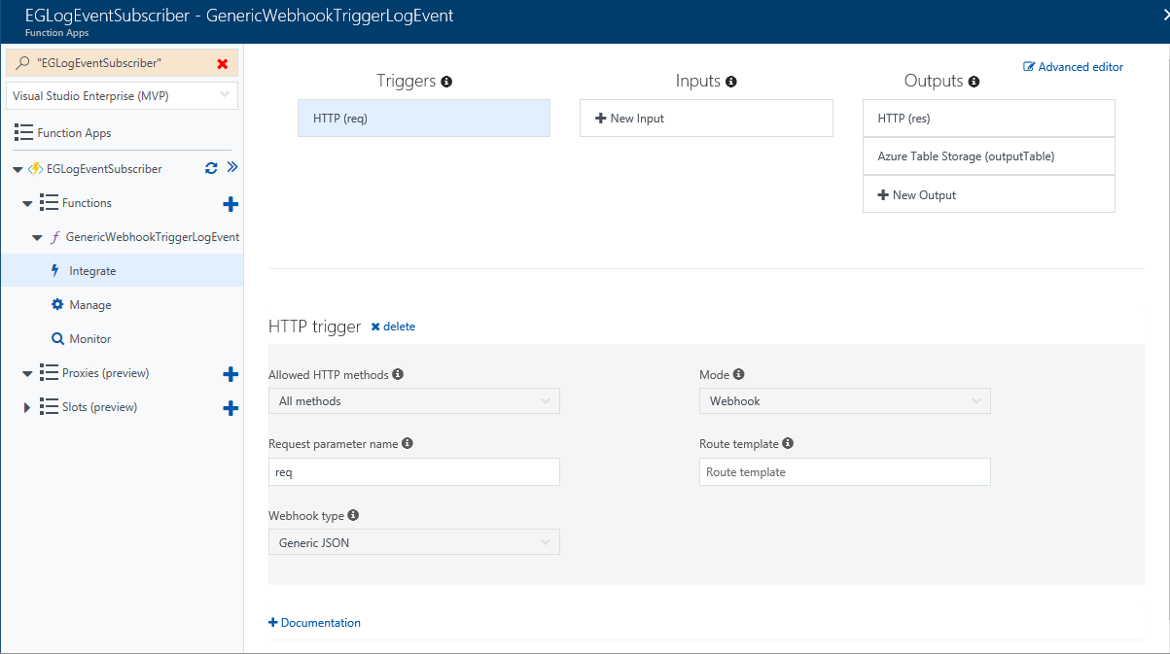
Creating the Event Subscriber (Function)

Slide 37
Creating the Event Subscriber (Logic App)
Create Logic App in same region as Event Grid topic
Create a Service Principal with Contributor rights on Event Grid topic
Resource Type should be Microsoft.EventGrid.topics
Be sure to select the Resource Name from the list
You may need to type something in first and then click the “x” to make list appear
https://docs.microsoft.com/en-us/azure/azure-resource-manager/resource-group-create-service-principal-portal
Notes:
If the Resource Name drop-down list does not display your Event Grid topic at first, type something in, save it and then click the “x”; the list should hopefully appear. It is important to select from the list as just typing the display name will not create the necessary resource ID in the topic field and the subscription will not be created.

Slide 38
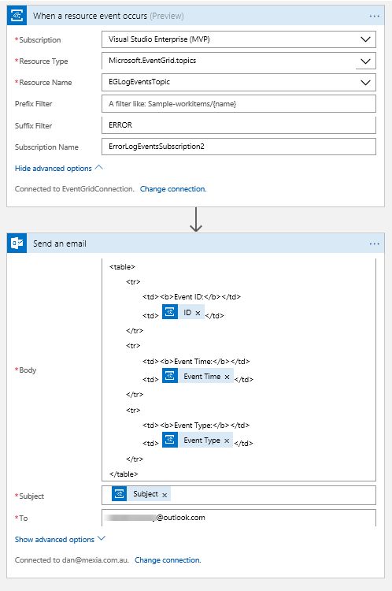
Creating the Event Subscriber (Logic App)
Notes:
If the Resource Name drop-down list does not display your Event Grid topic at first, type something in, save it and then click the “x”; the list should hopefully appear. It is important to select from the list as just typing the display name will not create the necessary resource ID in the topic field and the subscription will not be created.

Slide 39
Questions?

Slide 40

Learn more at azure.com/eventgrid
Documentation
docs.microsoft.com/azure/ event-grid/
Post questions at SO aka.ms/gridQuestions
Azure Serverless
azure.com/serverless

